Slide 1
A Sketch of Review-based Recommender System

Slide 2


Agenda
Introduction on Review-based Recommender System (RRS)
Development Course of Review-based Recommender System
Conventional RRS
Deep Learning for RRS
CNN, RNN and Attention Mechanism
Aspect based RRS
Exploiting Auxiliary Review
Summary
2

Slide 3
Introduction on Recommender System
Recommender System
Uncovers customer interests
Challenges
Natural sparsity of interaction data
Personalized recommendation

Slide 4
Introduction on Recommender System
Three main types of Recommender System
Interaction-based recommendation
Content-based recommendation (e.g. reviews, features, figures etc)
Hybrid recommendation (Interaction + Content)

Slide 5
Related Work: Interaction based Collaborative Filtering
Matrix Factorization (MF) is the most popular technique
Basic MF models: PMF [R. Salakhutdinov et al.NIPS’07], MF [Y. Koren et al. Computer’09]
Deep interaction-based model
Using restricted Boltzman machine (RBM): [R. Salakhutdinov et al. ICML’07, K. Georgiev et al. ICML’13]
Neural network-based Collaborative Filtering: NCF [X. He et al. WWW’17]
Drawbacks:
The performance drops significantly when the interaction record is sparse.
Interaction-based method cannot handle cold-start issue.
4

Slide 6
Exploitation of Review (Review-based Recommender System)
Values of review
User-generated content
Help to discover user’s opinions
Modeling new users: textual content tells more than numeric rating
5

Slide 7
Problem
Emphasis：
review modeling
5

Slide 8
Rating Prediction from Text
Using Topic Model to learn latent factors from text
HFT[J.J. McAuley et al.Recsys’13], CTR [C. Wang et al. KDD’11] and RBLT [Y. Tan et al. IJCAI’16]
These methods belong to the category of bag-of-words (BOW) models
Deep text-based model
BOW-based Deep Model: CDL [H. Wang et al. KDD’15]
MF + neural treatment: CMLE [W. Zhang et al. IJCAI’16], ConvMF[D.H. Kim et al. Recsys’16]
Parallel CNN models: DeepCoNN [L. Zhang et al. WSDM’17], TransNet [R. Catherine et al. Recsys’17]
Drawbacks:
These methods neglect the diverse and complex interactions between users and items .
Black-box property makes Deep models conduct less interpretable recommendation
8

Slide 9
Deep Learning with Attention for RRS
With attention mechanism, RRS can offer semantic interpretation for recommendation
Attention-based RRS
D-Attn [S. Seo et al. Recsys’17]: Combining local and global attention on review text
NARRE [C.Chen et al. WWW’18]: Predicting the rating and learning the usefulness of reviews
MPCN [Tay et al. KDD’18], CARL [Wu et al. TOIS’19], DAML [Liu et al. KDD’19]
Aspect-based RRS
CNN/RNN+Attention based network to extract aspect-level features
ANR [Chin et al. CIKM’18], CARP [Li et al. SIGIR’19], TarMF [Lu et al. WWW’18]
Offer better rating prediction accuracy and semantic interpretation
9

Slide 10
Agenda
Introduction on Review-based Recommender System (RRS)
Development Course of Review-based Recommender System
Conventional RRS
Deep Learning for RRS
CNN, RNN and Attention Mechanism
Aspect based RRS
Exploiting Auxiliary Review
Summary and Outlook
2

Slide 11
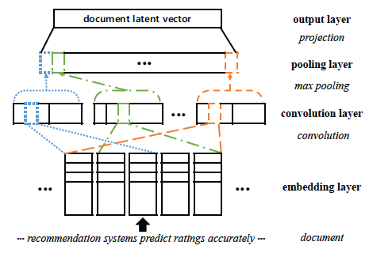
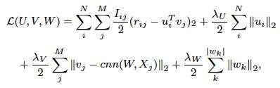

Deep Text-based model
Convolutional Matrix Factorization (ConvMF)
Utilizing CNN to extract item latent features from item reviews
Item Reviews
Review 1
Review 2
item i
Review m
item review doc
Donghyun Kim, Chanyoung Park, Jinoh Oh, Sungyoung Lee, Hwanjo Yu, Convolutional Matrix Factorization for Document Context-Aware Recommendation, Proceedings of
RecSys, 2016
22

Slide 12
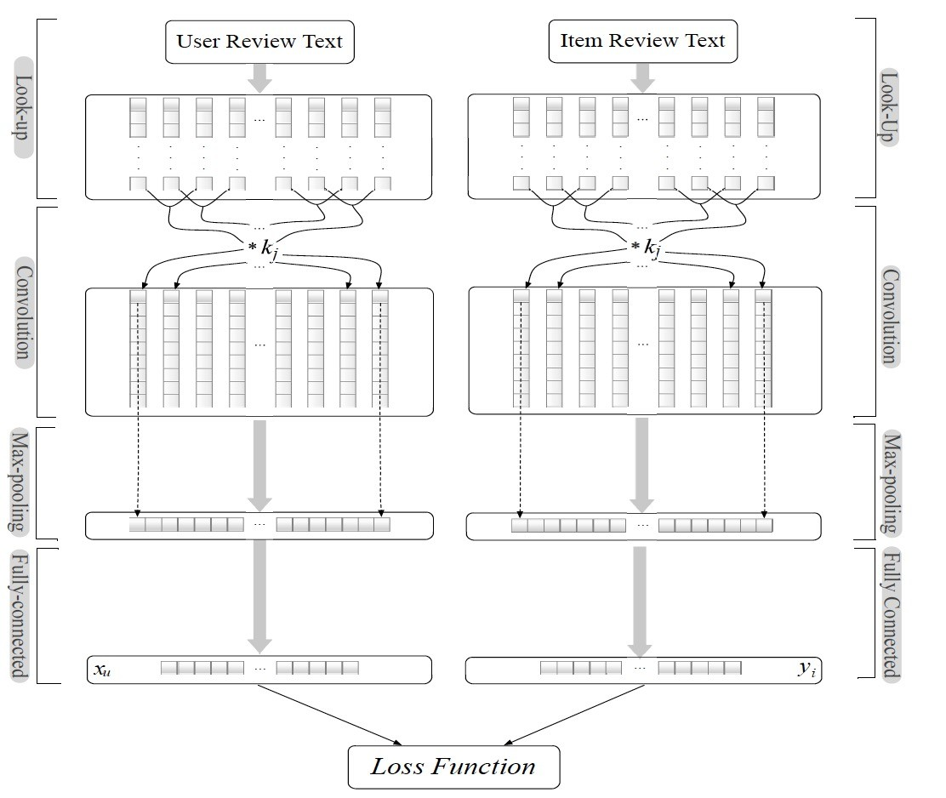

Deep Text-based model
Deep Cooperative Neural Networks (DeepCoNN)
Jointly modeling user & item reviews
Word embedding + Dual CNN
User & Item review Document
Review 1
Review 2
user u
Review n
user review doc
Review 1
Review 2
item i item review doc
Review m
Zheng L, Noroozi V, Yu P S. Joint deep modeling of users and items using reviews for recommendation, Proceedings of the Tenth ACM International Conference on Web Search
and Data Mining (WSDM), 2017: 425-434.
24

Slide 13



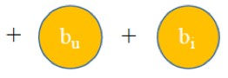
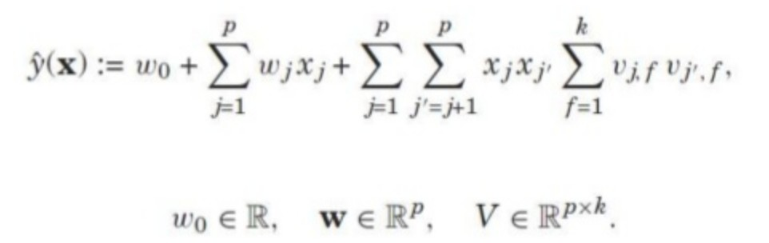
Deep Text-based model
Deep Cooperative Neural Networks (DeepCoNN)
t_{u}
t_{i}
Jointly modeling user & ite
Word embedding + Dual C
User & Item review D
Review 1
m reviews
NN
ocument
user review doc
Factorization Machine
Review 2
user u
Review n
Review 1
Review 2
item i
Review m
item review doc
ers and items using reviews for recommendation, Proceedings of the Tenth ACM
Zheng L, Noroozi V, Yu P S. Joint deep modeling of us
International Conference on Web Search
and Data Mining (WSDM), 2017: 425-434.
25

Slide 14
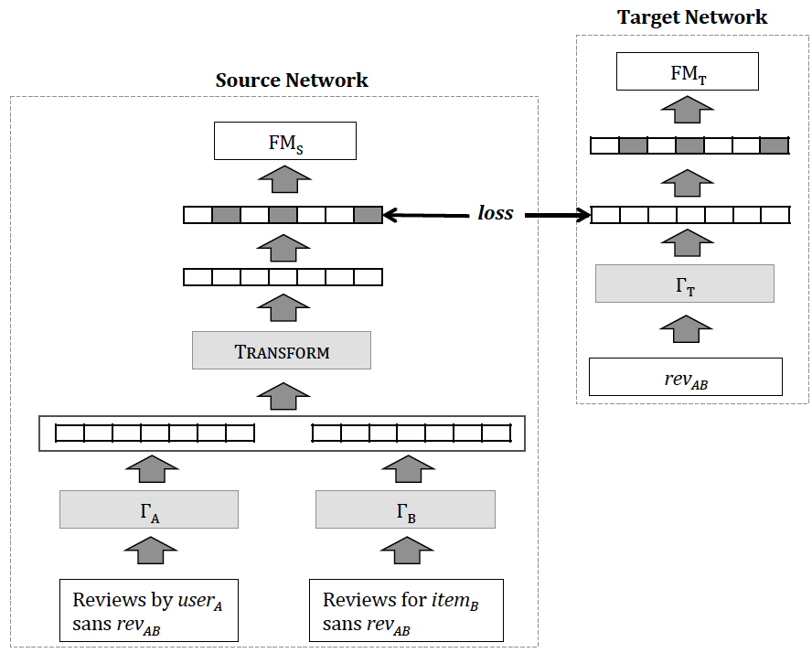


Deep Text-based model
Transformational Neural Networks (TransNet)
DeepCoNN performs well when target review is available
Extends DeepCoNN
Exploits target reviews in training
r
Target -> Source
Factorization Machine
CNN
item B
user A
review_{AB}
Catherine, Rose, and William Cohen. “Transnets: Learning to transform for recommendation.” Proceedings of the Eleventh ACM Conference on Recommender
Systems (RecSys). ACM, 2017.

Slide 15
Deep Text-based model
Transformational Neural Networks (TransNet)
DeepCoNN performs well when target review is available
Extends DeepCoNN
Exploits target reviews in training
r
Target -> Source
Factorization Machine
CNN
item B
user A
review_{AB}
Catherine, Rose, and William Cohen. “Transnets: Learning to transform for recommendation.” Proceedings of the Eleventh ACM Conference on Recommender
Systems (RecSys). ACM, 2017.

Slide 16
Deep Text-based model
Transformational Neural Networks (TransNet)
DeepCoNN performs well when target review is available
Extends DeepCoNN
Exploits target reviews in training
r
Target -> Source
Factorization Machine
CNN
item B
user A
review_{AB}
review_{AB}
review_{AB}
Catherine, Rose, and William Cohen. “Transnets: Learning to transform for recommendation.” Proceedings of the Eleventh ACM Conference on Recommender
Systems (RecSys). ACM, 2017.
16

Slide 17
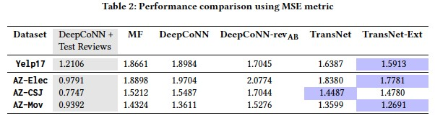
Deep Text-based model
Catherine, Rose, and William Cohen. “Transnets: Learning to transform for recommendation.” Proceedings of the Eleventh ACM Conference on Recommender
Systems (RecSys). ACM, 2017.

Slide 18
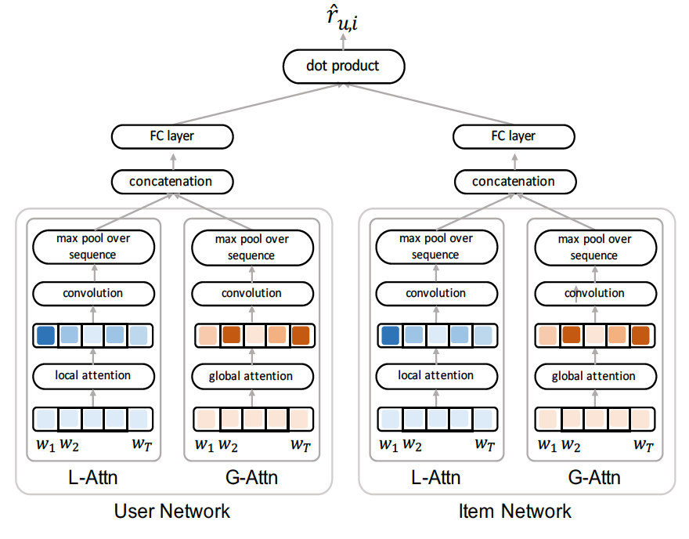
Attention-based RRS
Dual Local and Global attention (D-Attn)
First try enables interpretation of reviews based on neural network
Dual attention for selective features
Local: insight on preference (properties) over a local window
Global: globally semantic features
Seo S, Huang J, Yang H, et al. Interpretable convolutional neural networks with dual local and global attention for review rating prediction, Proceedings of the Eleventh ACM
Conference on Recommender Systems (RecSys), 2017: 297-305.
32

Slide 19
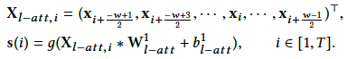
Attention-based RRS
Dual Local and Global attention (D-Attn)
First try enables interpretation of reviews based on ne
Dual attention for selective features
Local: insight on
Global: globally
ural network
window
preference (properties) over a local
semantic features
Seo S, Huang J, Yang H, et al. Interpretable convolutional neural networks with dual local and global attention for review rating prediction, Proceedings of the Eleventh ACM
Conference on Recommender Systems (RecSys), 2017: 297-305.
32

Slide 20
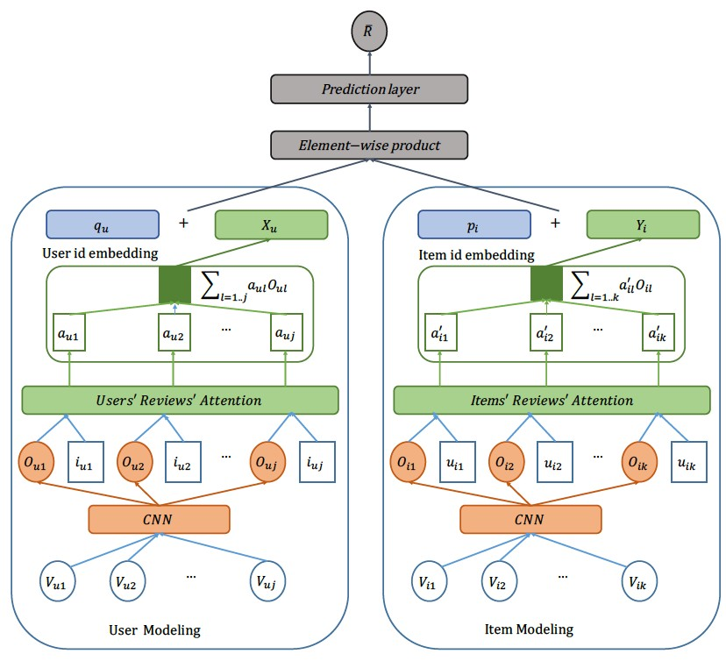
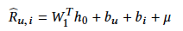

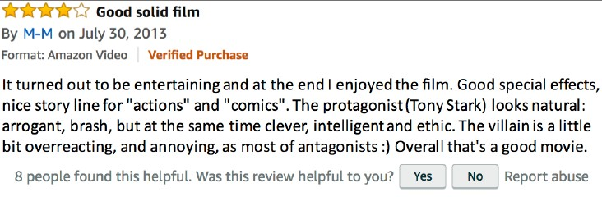
Attention-based RRS
Neural Attentional Regression with Review-level Explanation (NARRE)
Few models consider the usefulness of reviews
Useful reviews advance prediction accuracy
Chen C, Zhang M, Liu Y, et al. Neural attentional rating regression with review-level explanations, Proceedings of the 2018 Conference on World Wide Web (WWW),
2018: 1583-1592.

Slide 21

Disadvantage of separate modeling of user items
User historical reviews include comments on various types of items
This is my favourite restaurant
User A
The quality of chair is good
I do not like bitter coffee
Item A

Slide 22
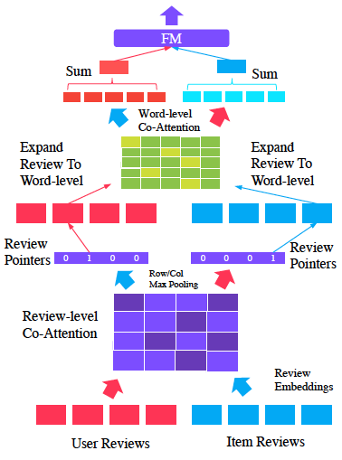
Attention-based RRS
Multi-Pointer Co-Attention Networks (MPCN)
Co-Attention to identify the most important reviews
Co-Attention to identify the most important words in these reviews
Chen C, Zhang M, Liu Y, et al. Neural attentional rating regression with review-level explanations, Proceedings of the 2018 Conference on World Wide Web (WWW),
2018: 1583-1592.

Slide 23
Attention-based RRS
Multi-Pointer Co-Attention Networks (MPCN)
Co-Attention to identify the most important reviews
Co-Attention to identify the most important words in these reviews
Chen C, Zhang M, Liu Y, et al. Neural attentional rating regression with review-level explanations, Proceedings of the 2018 Conference on World Wide Web (WWW),
2018: 1583-1592.

Slide 24
Attention-based RRS
Multi-Pointer Co-Attention Networks (MPCN)
Co-Attention to identify the most important reviews
Co-Attention to identify the most important words in these reviews
Chen C, Zhang M, Liu Y, et al. Neural attentional rating regression with review-level explanations, Proceedings of the 2018 Conference on World Wide Web (WWW),
2018: 1583-1592.

Slide 25
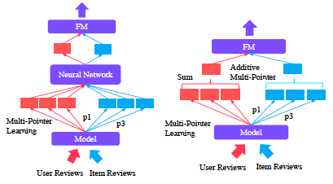
Attention-based RRS
Multi-Pointer Co-Attention Networks (MPCN)
Co-Attention to identify the most important reviews
Co-Attention to identify the most important words in these reviews
Chen C, Zhang M, Liu Y, et al. Neural attentional rating regression with review-level explanations, Proceedings of the 2018 Conference on World Wide Web (WWW),
2018: 1583-1592.

Slide 26
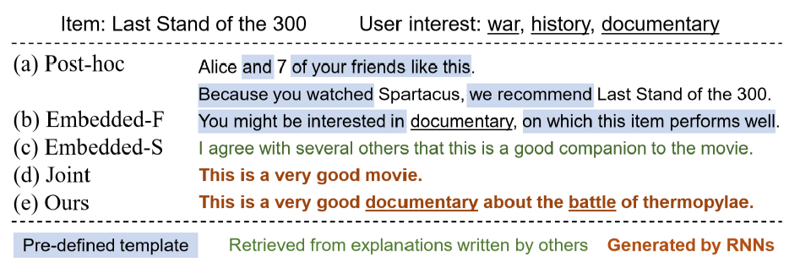
Attention-based RRS
Challenges
Explanations are not explicit
User and item embeddings do not contain sufficient information of deep user-item interactions
Zhongxia Chen. Co-Attentive Multi-Task Learning for Explainable Recommendation, Proceedings of IJCAI 2019.

Slide 27
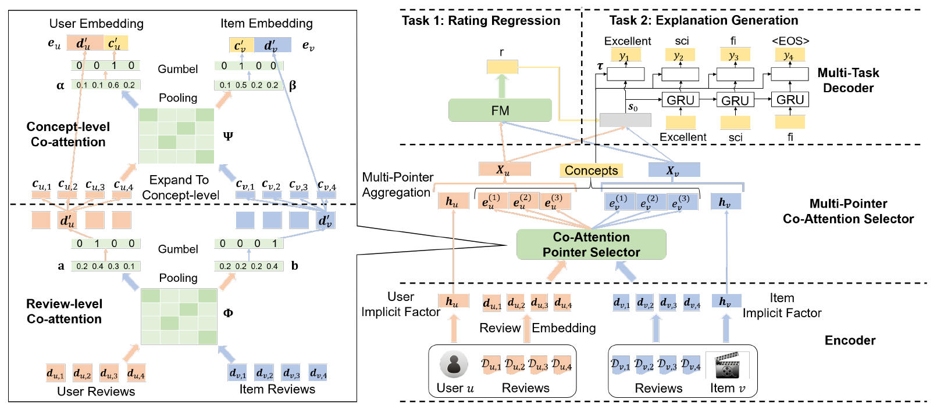
Attention-based RRS
Zhongxia Chen. Co-Attentive Multi-Task Learning for Explainable Recommendation, Proceedings of IJCAI 2019.

Slide 28
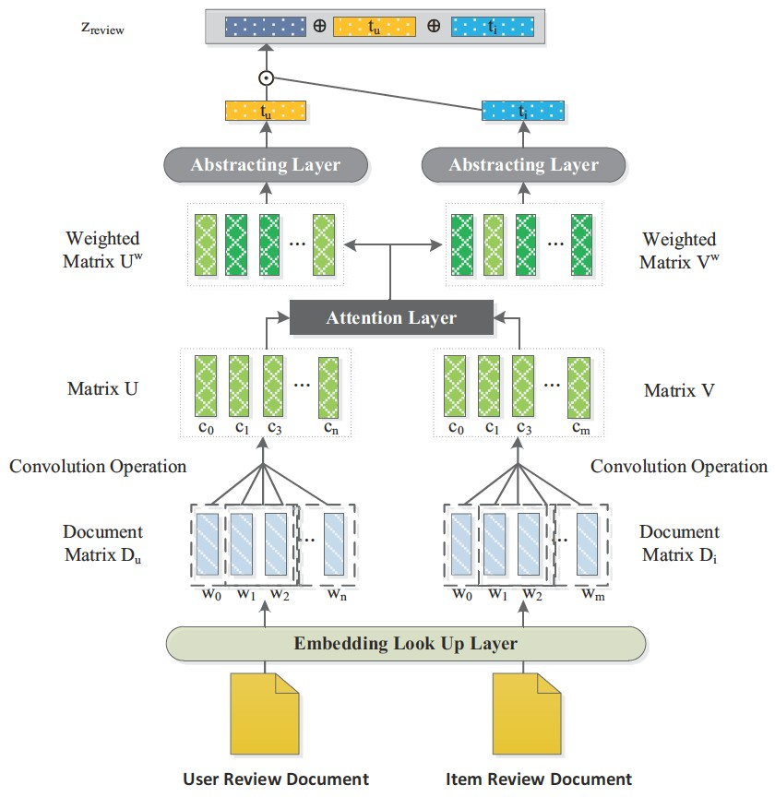
Attention-based RRS
Architecture of CARL
Libing Wu, Cong Quan, Chenliang Li, Qian Wang, Bolong Zheng, Xiangyang
Luo, A
Context-Aware User-Item Representation Learning for Item Recommendation, ACM
51
Transactions on Information Sysems (TOIS), 2019, 37

Slide 29
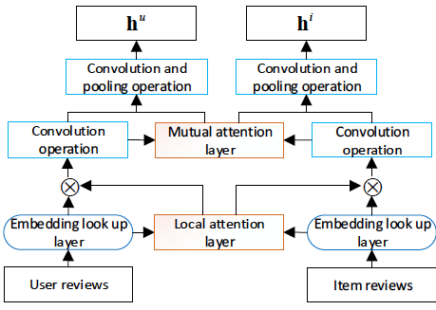
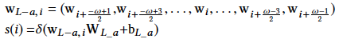
Attention-based RRS
Dual Attention Mutual Learning between Ratings and Reviews (DAML)
A local attention layer to identify the important words before CNN
Utilize neural factorization machines [He and Chua SIGIR’17] for rating prediction
Similar to D-Attn
Donghua Liu, Jing Li, Bo Du, Jun Chang, Rong Gao. DAML: Dual Attention Mutual Learning between Ratings and Reviews for Item Recommendation, Proceedings of KDD
2019.

Slide 30
Attention-based RRS
Dual Attention Mutual Learning between Ratings and Reviews (DAML)
A local attention layer to identify the important words before CNN
Utilize neural factorization machines [He and Chua SIGIR’17] for rating prediction
Donghua Liu, Jing Li, Bo Du, Jun Chang, Rong Gao. DAML: Dual Attention Mutual Learning between Ratings and Reviews for Item Recommendation, Proceedings of KDD
2019.

Slide 31
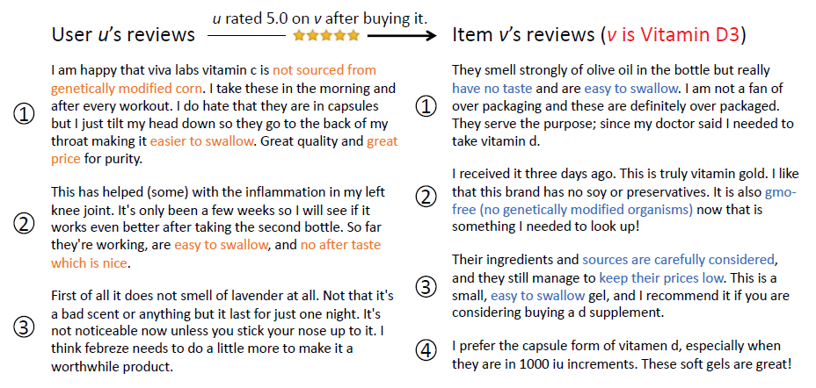
Attention-based RRS
Asymmetrical Hierarchical Networks with Attentive Interactions for Interpretable Review-Based Recommendation
Vitamin D3
Vitamin D3
medication
air freshener
Xin Dong. Asymmetrical Hierarchical Networks with Attentive Interactions for Interpretable Review-Based Recommendation, Proceedings of AAAI 2020.

Slide 32
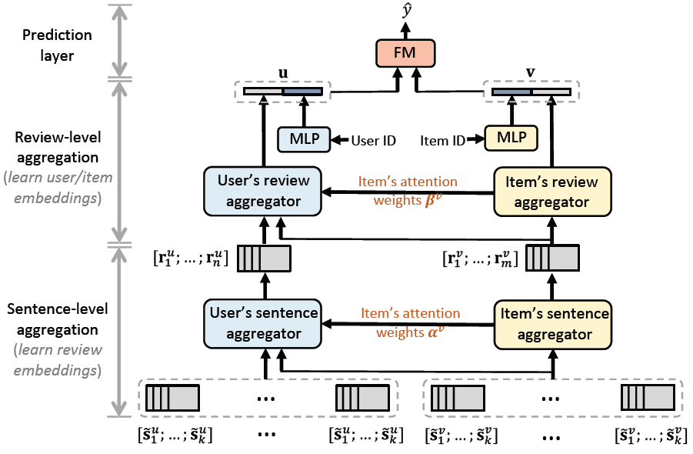
Attention-based RRS
Asymmetrical Hierarchical Networks with Attentive Interactions for Interpretable Review-Based Recommendation
Xin Dong. Asymmetrical Hierarchical Networks with Attentive Interactions for Interpretable Review-Based Recommendation, Proceedings of AAAI 2020.

Slide 33
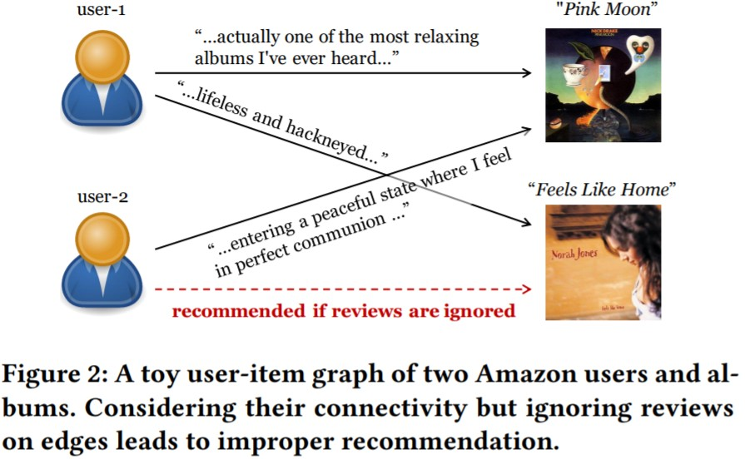
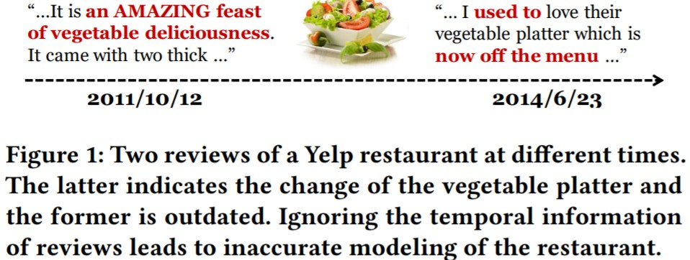
Challenge
Attention-based RRS
cannot capture short-term changes of
user preferences and item features
cannot accurately model high-order collaborative signals of users and items
Jingyue Gao, Yang Lin, Yasha Wang, Xiting Wang, Zhao Yang, Yuanduo He, and Xu Chu. 2020. Set-Sequence-Graph: A Multi-View Approach Towards Exploiting Reviews for Recommendation. In CIKM2020
128

Slide 34
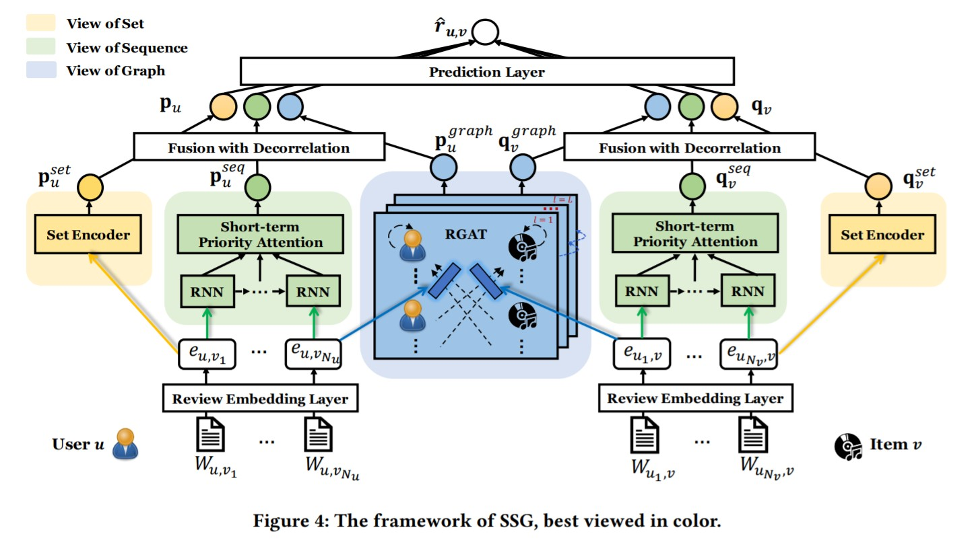
Overview
Attention-based RRS
a three-way encoder
View of Set
View of Sequence
View of Graph
Jingyue Gao, Yang Lin, Yasha Wang, Xiting Wang, Zhao Yang, Yuanduo He, and Xu Chu. 2020. Set-Sequence-Graph: A Multi-View Approach Towards Exploiting Reviews for Recommendation.
In CIKM2020
34

Slide 35
Agenda
Introduction on Review-based Recommender System (RRS)
Development Course of Review-based Recommender System
Conventional RRS
Deep Learning for RRS
CNN, RNN and Attention Mechanism
Aspect based RRS
Exploiting Auxiliary Review
Summary and Outlook
2

Slide 36
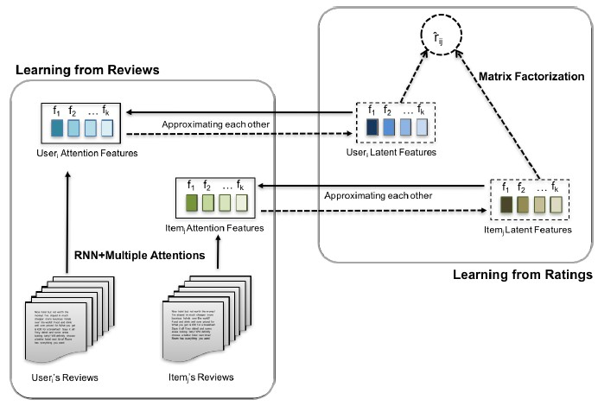
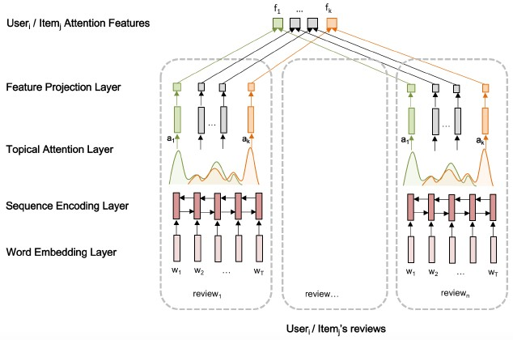
Aspect-based RRS
Topical Attention Regularized Matrix Factorization (TARMF)
Utilize BiLSTM to extract contextual features
Identify important words for each topic/aspect
Lu Y, Dong R, Smyth B. Coevolutionary recommendation model: Mutual learning between ratings and reviews[C]//Proceedings of the 2018 World Wide Web Conference. 2018: 773-782.

Slide 37
Aspect-based RRS
Topical Attention Regularized Matrix Factorization (TARMF)
Utilize BiLSTM to extract contextual features
Identify important words for each topic/aspect
Lu Y, Dong R, Smyth B. Coevolutionary recommendation model: Mutual learning between ratings and reviews[C]//Proceedings of the 2018 World Wide Web Conference. 2018: 773-782.

Slide 38
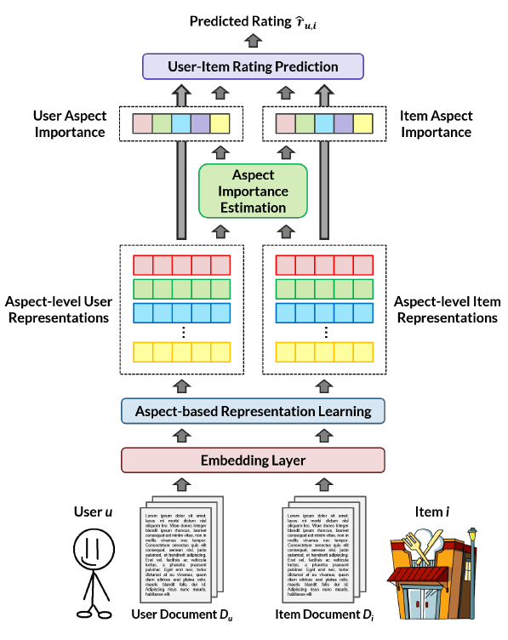
Aspect-based RRS
Aspect-based Neural Recommender (ANR)
Aspect-level features extracted from the reviews
Identify the aspect correlation between items and users.
K topic vectors
Jin Yao Chin, Kaiqi Zhao, Shafiq Joty, Gao Cong. ANR: Aspect-based Neural Recommender, Proceedings of CIKM, 2018: 147-156.

Slide 39
Agenda
Introduction on Review-based Recommender System (RRS)
Development Course of Review-based Recommender System
Conventional RRS
Deep Learning for RRS
CNN, RNN and Attention Mechanism
Aspect based RRS
Exploiting Auxiliary Review
Summary and Outlook
2

Slide 40


Exploiting Auxiliary Review
Challenges
Most users leave no comments for products purchased
Performance degradation when the review text is scarce
Sara Handley
Five Stars
January 24, 2018
Size: Large 42/44 Veriﬁed Purchase
Loved it!
43

Slide 41
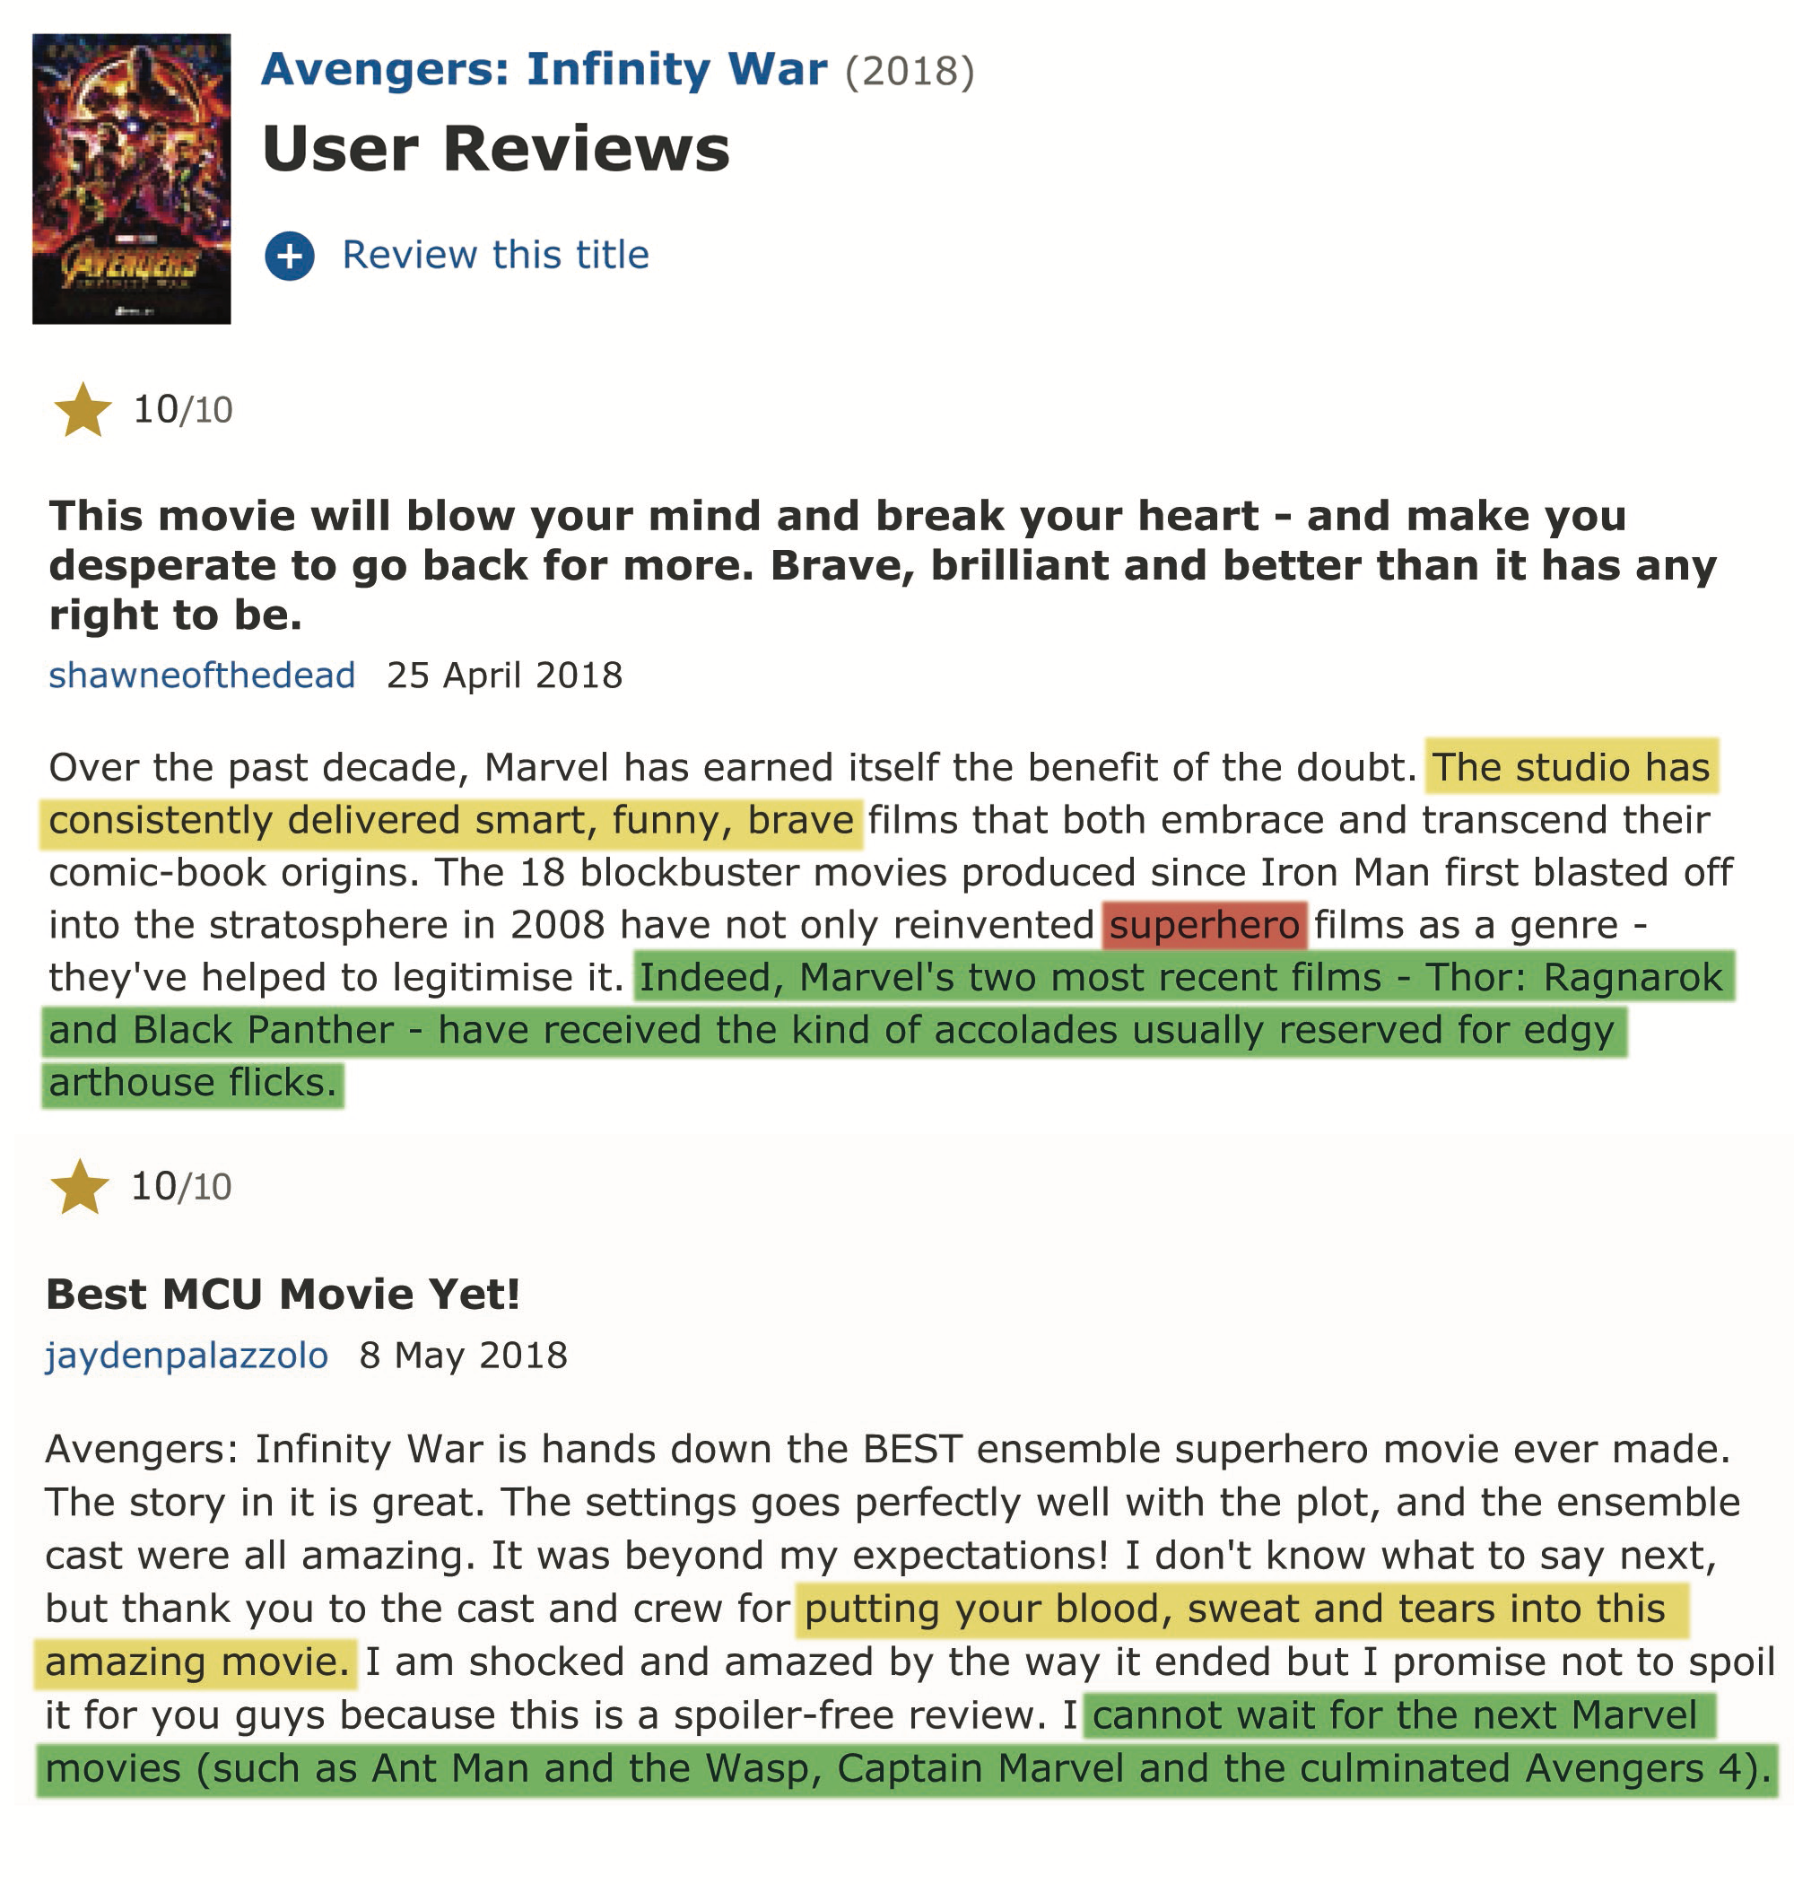



Exploiting Auxiliary Review
Goal: exploit user-item pair-dependent features from auxiliary reviews written by
like-minded users (PARL)
Like-minded users: give similar ratings toward the same item
Auxiliary reviews: reviews written by like-minded users
Shawn would like Ant Man
Jayden is superhero fan
Feature incompatible
Libing Wu, Cong Quan, Chenliang Li, Donghong Ji. PARL: Let Strangers Speak Out What You Like, Proceedings of CIKM 2018.

Slide 42
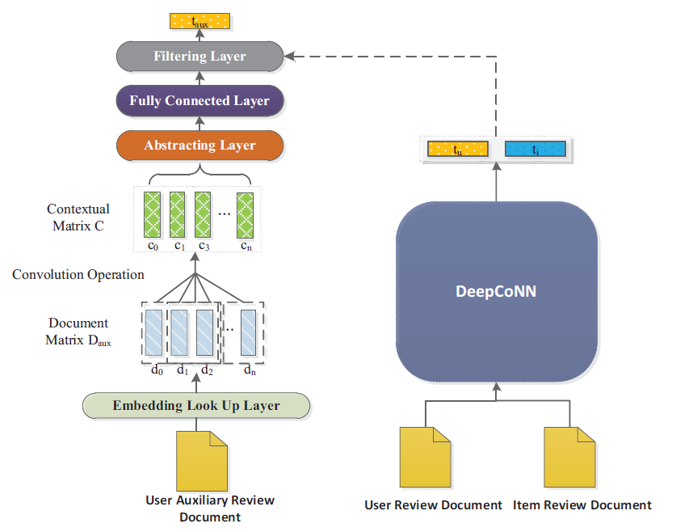
Exploiting Auxiliary Review
An auxiliary review: written by other user with similar rating score as given by the target user.
Similar rating = [rating, rating + 1, rating - 1]
Libing Wu, Cong Quan, Chenliang Li, Donghong Ji. PARL: Let Strangers Speak Out What You Like, Proceedings of CIKM 2018.

Slide 43
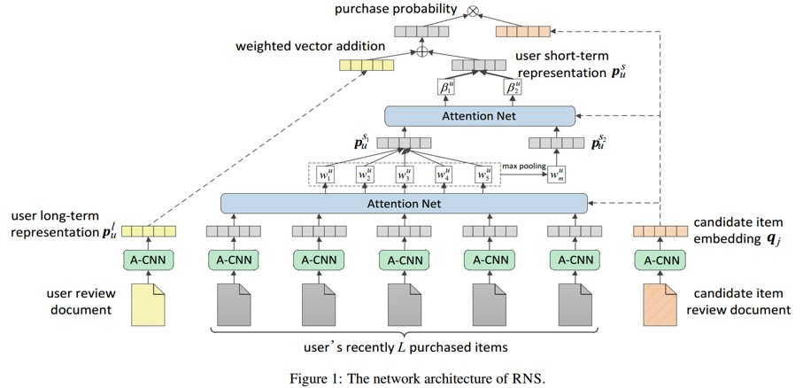
Exploiting Auxiliary Review
user’s preference is dynamic
Chenliang Li, Xichuan Niu, Xiangyang Luo, Zhenzhong Chen, Cong Quan.A Review-Driven Neural Model for Sequential Recommendation, Proceedings of IJCAI 2019.

Slide 44
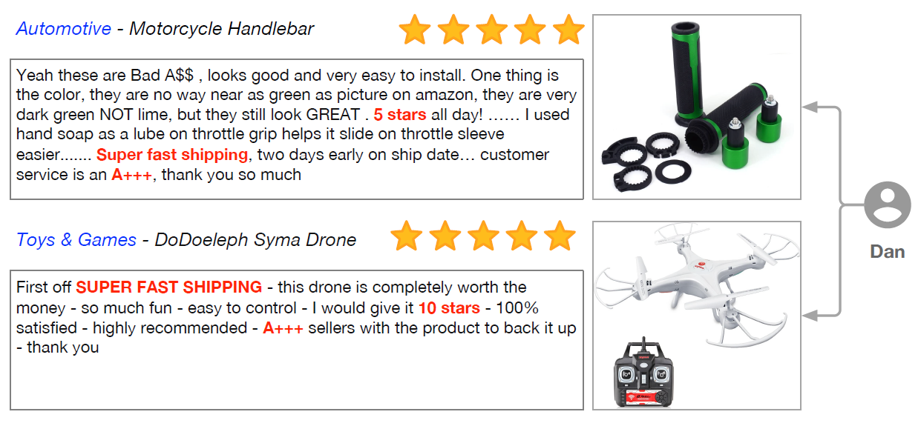
Exploiting Auxiliary Review
Challenges
In less popular domains, reviews will be insufficient to obtain a comprehensive user representation
.Zhaopeng Qiu. U-BERT: Pre-training User Representations for Improved Recommendation. AAAI2021
128

Slide 45
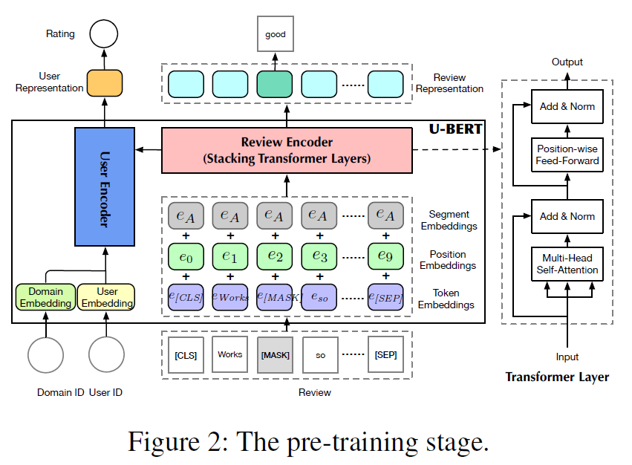
Exploiting Auxiliary Review
The pre-training stage
predict rating
predice opinion word （50% mask）
.Zhaopeng Qiu. U-BERT: Pre-training User Representations for Improved Recommendation. AAAI2021
128

Slide 46
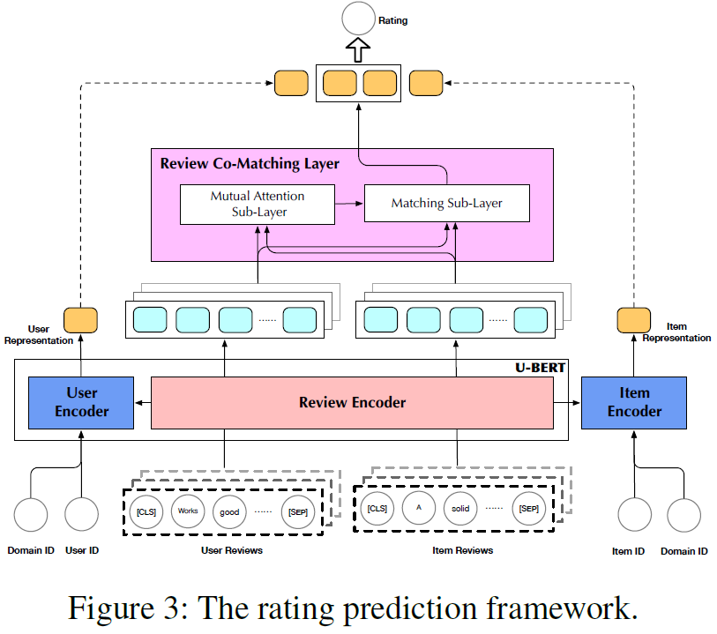
Exploiting Auxiliary Review
The rating prediction stage
.Zhaopeng Qiu. U-BERT: Pre-training User Representations for Improved Recommendation. AAAI2021
128

Slide 47
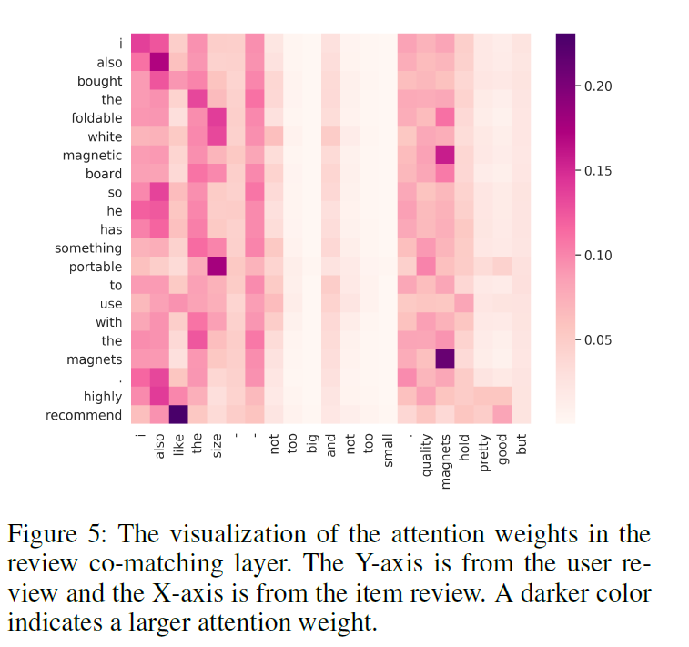
Exploiting Auxiliary Review
Case Study
.Zhaopeng Qiu. U-BERT: Pre-training User Representations for Improved Recommendation. AAAI2021
128

Slide 48
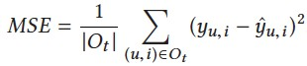
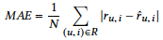
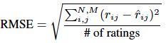
Summary
Rating Prediction
Mean Squared Error (MSE)
Mean Absolute Error (MAE)
Root Mean Squared Error (RMSE)
TOP-N
Precision
Recall
NDCG
Hit Rate
145

Slide 49
Reference
ChongWang and David M. Blei. 2011. Collaborative topic modeling for recommending scientific articles. In Proceedings of the 17th ACM SIGKDD International Conference on Knowledge Discovery and DataMining, San Diego, CA. ACM, 448–456.
Yunzhi Tan, Min Zhang, Yiqun Liu, and Shaoping Ma. 2016. Rating-boosted latent topics: Understanding users and items with ratings and reviews. In Proceedings of the 25th International Joint Conference on Artificial Intelligence, New York, NY. I3JCAI/AAAI Press, 2640–2646
4Hao Wang, Naiyan Wang, and Dit-Yan Yeung. 2015. Collaborative deep learning for recommender systems. In Proceedings of the 21th ACM SIGKDD International Conference on Knowledge Discovery and Data Mining, Sydney, NSW. ACM, 1235–1244
5 Wei Zhang, Quan Yuan, Jiawei Han, and Jianyong Wang. 2016. Collaborative multi-level embedding learning from reviews for rating prediction. In Proceedings of the 25th International Joint Conference on Artificial Intelligence, New York, NY. IJCAI/AAAI Press, 259–272.
Dong Hyun Kim, Chanyoung Park, Jinoh Oh, Sungyoung Lee, and Hwanjo Yu. 2016. Convolutional matrix factorization for document context-aware recommendation. In Proceedings of the 10th ACM Conference on Recommender Systems, Boston, MA. ACM, 233–240
Yi Tay, Anh Tuan Luu, and Siu Cheung Hui. 2018. Multi-Pointer Co-Attention Networks for Recommendation. In KDD. 2309–2318
Jin Yao Chin, Kaiqi Zhao, Shafiq Joty, and Gao Cong. 2018. ANR: Aspect-based Neural Recommender. In CIKM. 147–156
Yichao Lu, Ruihai Dong, and Barry Smyth. 2018. Coevolutionary Recommendation Model: Mutual Learning between Ratings and Reviews. In WWW. 773–782.
Yongfeng Zhang, Guokun Lai, Min Zhang, Yi Zhang, Yiqun Liu, and Shaoping Ma. 2014. Explicit Factor Models for Explainable Recommendation based on Phrase-level Sentiment Analysis. In SIGIR. 83–92.

Slide 50
Reference
McAuley, Julian, and Jure Leskovec. “Hidden factors and hidden topics: understanding rating dimensions with review text.” Proceedings of the 7th ACM conference on Recommender systems. ACM, 2013.
Tan Y, Zhang M, Liu Y, et al. Rating-Boosted Latent Topics: Understanding Users and Items with Ratings and Reviews, IJCAI. 2016, 16: 2640-2646.
Zheng L, Noroozi V, Yu P S. Joint deep modeling of users and items using reviews for recommendation, Proceedings of the Tenth ACM International Conference on Web Search and Data Mining. ACM, 2017: 425-434.
Catherine, Rose, and William Cohen. “Transnets: Learning to transform for recommendation.” Proceedings of the Eleventh ACM Conference on Recommender Systems. ACM, 2017.
Seo S, Huang J, Yang H, et al. Interpretable convolutional neural networks with dual local and global attention for review rating prediction, Proceedings of the Eleventh ACM Conference on Recommender Systems. ACM, 2017: 297-305.
Chen C, Zhang M, Liu Y, et al. Neural attentional rating regression with review-level explanations, Proceedings of the 2018 World Wide Web Conference on World Wide Web. International World Wide Web Conferences Steering Committee, 2018: 1583-1592.
Libing Wu, Cong Quan, Chenliang Li, Donghong Ji. PARL: Let Strangers Speak Out What You Like, Proceedings of the 27th ACM International Conference on Information and Knowledge Management. ACM, 2018: 677-686.
Wu L, Quan C, Li C, et al. A context-aware user-item representation learning for item recommendation[J]. ACM Transactions on Information Systems (TOIS), 2019, 37(2): 22.
Chenliang Li, Cong Quan et al. A Capsule Network for Recommendation and Explaining What You Like and Dislike, SIGIR 2019

Slide 51
Thanks!

